Slide 1
MACHINE LEARNING
LINEAR REGRESSION

Slide 2
Linear regression
It is an approach for modelling the relationship between scalar dependent variable y and one or more explanarory variables x
If we have one explanatory variable → simple linear regression
For example: we want to approximate the price of houses if we know the size // single explanatory variable
If we have several explanatory variable → multiple linear regression
For example: we want to approximate the price of houses if we know the size, number of bedrooms ...
We use linear predictor functions → this is why it is LINEAR regression

Slide 3
prices [$]
500
400
300
200
100
2
size of houses [m ]
1000
2000
3000
4000

Slide 4
X [m*m] | Y [$]
1120 | 112
1523 | 345
2102 | 198
2230 | 305
2600 | 372
3200 | 550
3409 | 302
3689 | 420
4460 | 578

Slide 5
prices (y)
H(x) = a + b*x
price = a + b * size
500
400
300
200
100
size of houses (x)
1000
2000
3000
4000

Slide 6
prices (y)
H(x) = a + b*x
price = a + b * size
500
400
It is a linear model
~ little change in the size causes
little change in the price
// NOT ALWAYS A GOOD MODEL !!!
300
200
100
size of houses (x)
1000
2000
3000
4000

Slide 7
prices (y)
H(x) = a + b*x
price = a + b * size
500
400
300
200
100
size of houses (x)
1000
2000
3000
4000

Slide 8

Linear regression
We should choose a and b parameters so that H(x) is close to y for our training examples (x,y) !!!
So: minimize ${[H\left(x\right)−y]}^{2}$
We have to choose the parameters a and b to make it a minimum
We can solve it with gradient descent, in higher dimensions it is very efficient
Or we can solve it with design matrices if there are not much features: matrix operations are expensive in higher dimensions

Slide 9

this is the prediction from
our linear model
min ${[H\left(x\right)−y]}^{2}$
a,b
we want to find the minimum by
tuning these parameters
this is the value we know from
the training data
// supervised learning !!!

Slide 10
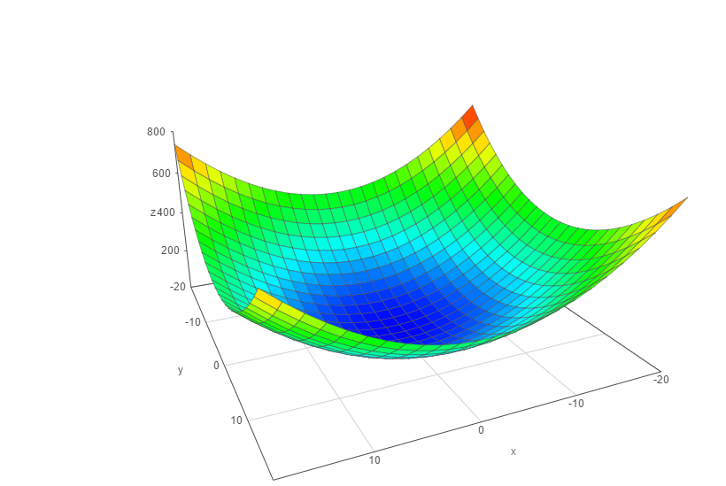
Gradient descent
min C(a,b)
a
b

Slide 11


Gradient descent
gradient descent
We have to know the partial derivative of the cost function
and go to the direction of the gradient
// gradient ~ partial derivative
$$\frac{∂C(a,b)}{∂a}$$
$$\frac{∂C(a,b)}{∂b}$$

Slide 12
Gradient descent
b
Contour lines → the regions on which the
values of C(a,b) function are constant !!!
a

Slide 13
Gradient descent
b
a

Slide 14
Gradient descent
b
a

Slide 15
Gradient descent
b
a

Slide 16
Gradient descent
b
a

Slide 17
prices (y)
H(x) = a + b*x
price = a + b * size
500
400
300
200
100
size of houses (x)
1000
2000
3000
4000

Slide 18

prices (y)
500
run
400
rise
300
Two important coefficients:
1.) intercept: the point where the graph
of the function intersects the y-axis
2.) slope: steepness of the function
$\frac{rise}{run}$ = $\frac{change in y}{change in x}$
200
100
size of houses (x)
1000
2000
3000
4000

